Slide 1

Project Ideas
Dare 3D
Davina, Alejandra, Ray, Elizabeth

Slide 2



The project should represent each of our skills
Notes:
My goal for this project is _________
Ray: Programming mechanics, music, sound.
Ale: Programming, help with art

Slide 4
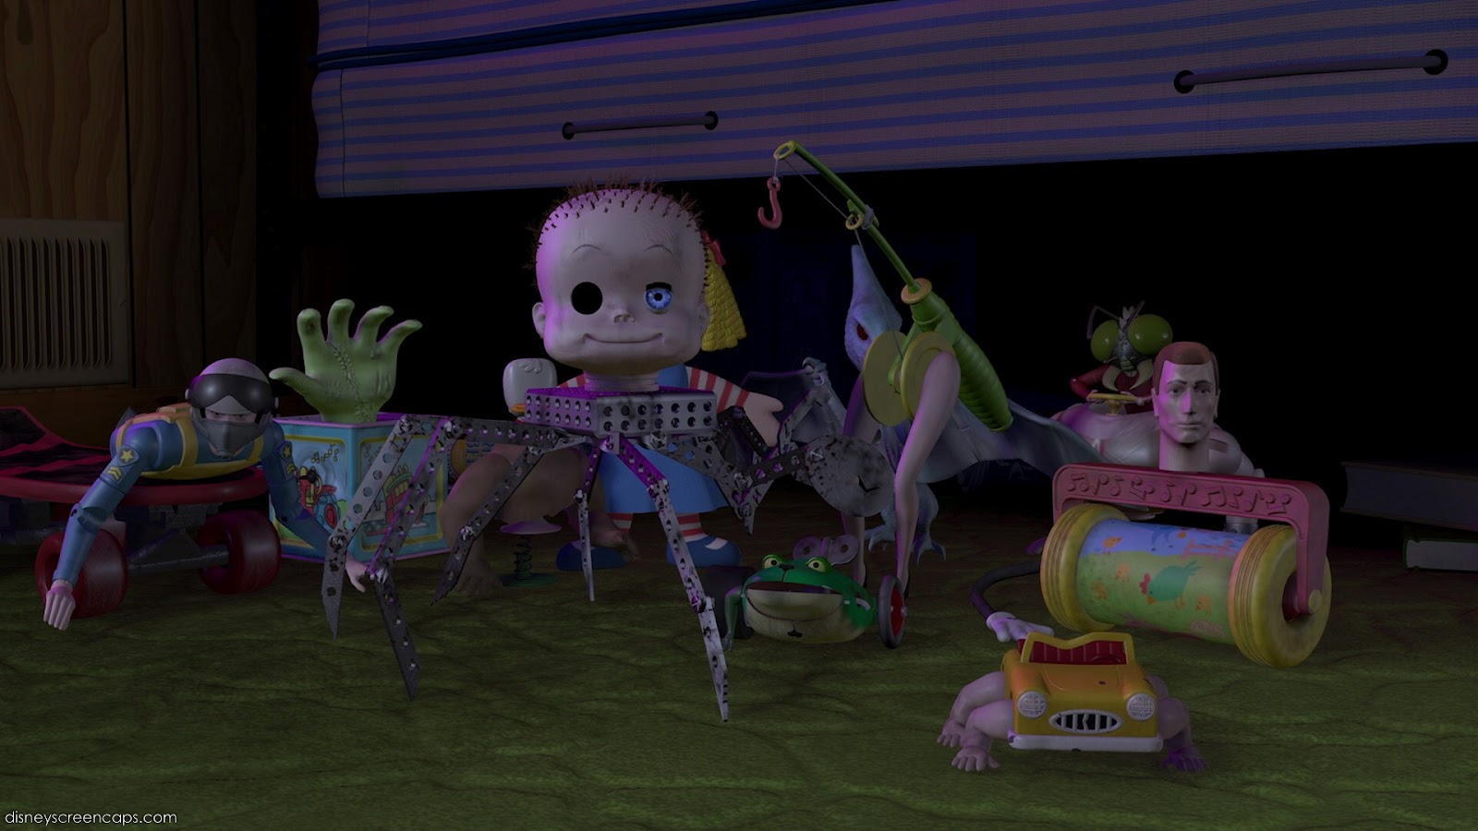
Idea 1: Toy box
First Person
Puzzle
Key features:
Activator device (s)
Things to be activated (different toys)
Dark toy themed aesthetic
One floor of a doll house
Notes:
Activator is based on a mechanic from Liz’s 1001 Project
Use the activator to interact with toys and elements in the environment.

Slide 5
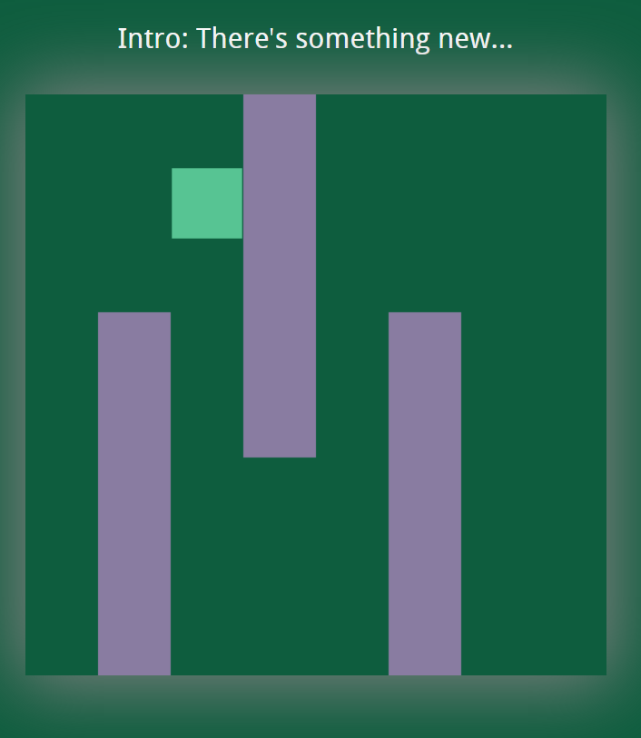
Idea 2: Dimensional Shift
First Person
Puzzle
Key features
Changing dimensions to see obstacles/signs/interactable puzzle mechanics
Inspired by 3D
Haunted theme
Tutorial and a level or two
Notes:
Visual /Audio cues for changes
Aesthetic of demon/ghost dimensions
Story aspects/puzzle clues only in certain dimensions

Slide 6


